Slide 1
Hiring Workflow Overview
Spatial Alphabet

Slide 2
Hiring Workflow Overview
Hiring Workflow Process
Process Overview
Job Requirement and Posting
Application Screening
Phone Screening
Face-to-Face Interview
Candidate Review
Offer and Acceptance
Onboarding
Conclusion

Slide 3
Hiring Workflow Overview
Q&A
Thank You

Slide 4
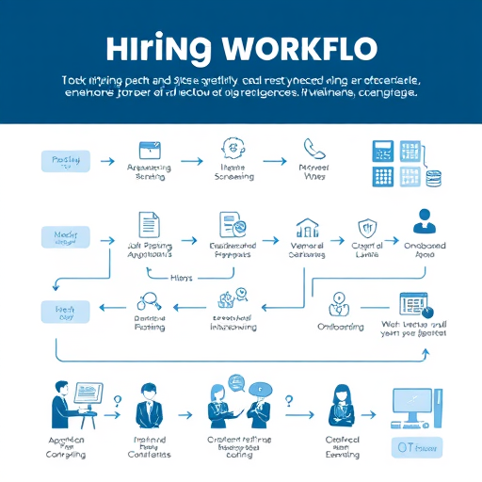
Hiring Workflow Process
Job Posting: Craft compelling job descriptions that attract suitable candidates while outlining essential qualifications.
Application Review: Utilize ATS to streamline application sorting, filtering based on specified criteria and qualifications.
Onboarding Process: Implement a structured onboarding plan to integrate new hires efficiently into organizational culture.
Generated on aidocmaker.com

Slide 5
Process Overview
Hiring Manager Role: The Hiring Manager oversees job requirements, ensures alignment with team goals, prepare pre-screening questionnaire and conducts interviews.
HR/Recruiter Role: The HR/Recruiter manages candidate outreach, relationship building, and ensures compliance throughout hiring processes.
ATS Functionality: The Applicant Tracking System facilitates automated processing, enhancing efficiency in managing candidate data and communications.

Slide 6
Job Requirement and Posting
Needs Identification: Hiring Manager assesses team requirements and determines specific skills required for the position.
Job Description Creation: Crafting detailed job descriptions, Hiring Manager specifies qualifications, responsibilities, and organizational culture fit.
Job Posting Execution: HR/Recruiter uploads finalized job descriptions into ATS, ensuring accurate dissemination across multiple job platforms.

Slide 7
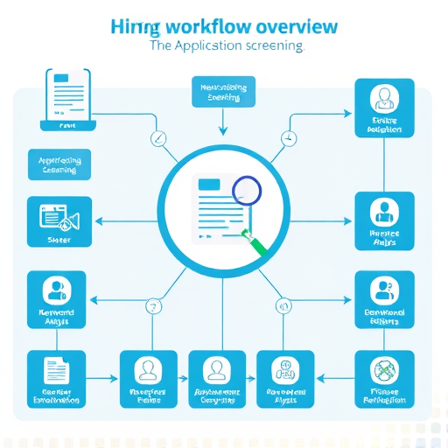
Application Screening
Application Screening Process: HR/Recruiter evaluates candidates' applications against essential criteria to identify potential or unsuitable candidates.
Candidate Evaluation Criteria: Basic requirements include relevant experience, skills, and educational background that align with job specifications.
Next Steps Decision: Based on assessments and Rank candidates are either invited for phone screening or notified of rejection via email.
Generated on aidocmaker.com

Slide 8
Candidates rank
1.Tech stack
2.Experience
3.Availability
4.BackGround Check
5.WFO(client loc)/Hybrid/remote/
6.Accountability
7.Transprency
8.Financally
9.Ecthically
10.Fair enough
11.location

Slide 9
Phone Screening
Phone Screening Purpose: Conduct initial interviews to assess candidates’ qualifications and determine suitability for face-to-face discussions.
Assessment Criteria: Evaluate candidates based on specific skills, experience, and job requirements to ensure alignment.
Outcome of Screening: Results in scheduling interviews for suitable candidates or issuing rejection emails to others.

Slide 10
Face-to-Face Interview
Interview Scheduling: HR/Recruiter coordinates with hiring managers and interview teams to schedule face-to-face interviews efficiently.
Preparation of Review Questions: HR/Recruiter assigns targeted review questions that align with core competencies essential for the role.
Note Taking Protocols: Interviewers should document observations and impressions comprehensively for informed candidate evaluation discussions.

Slide 11
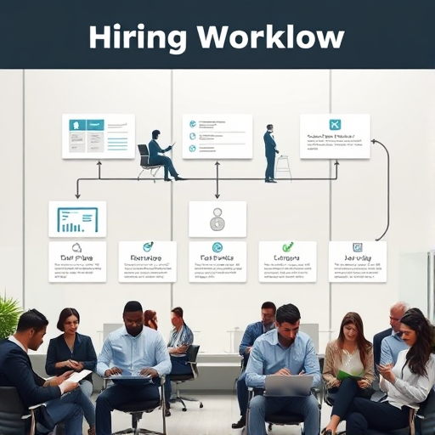
Candidate Review
Candidate Review Meeting: Collaborative review of top candidates occurs, ensuring alignment with job requirements and organizational culture.
Decision-Making Process: Evaluate candidates' fit, leading to either an offer probability assessment or rejection email preparations.
Offer Probability Assessment: Determine candidates’ likelihood of receiving offers based on discussions, interviews, and overall fit evaluation.
Generated on aidocmaker.com

Slide 12
Offer and Acceptance
Offer Letter Email: HR sends an official offer letter via email to the selected candidate detailing position specifics.
Acceptance Decision Point: Upon receiving the offer, a pivotal decision point determines candidate acceptance or need for follow-up.
Onboarding Initiation: If accepted, onboarding commences promptly, ensuring new hires acclimate effectively into organizational structures.

Slide 13
Onboarding
Onboarding System Integration: HR adds the new employee's information into the onboarding system, facilitating smooth acclimatization processes.
Welcome Email Dispatch: A thank-you email is sent to the new hire, expressing excitement and providing essential onboarding information.
Role Introduction Sessions: Organize introductory sessions to familiarize new employees with key team members and organizational culture.

Slide 14
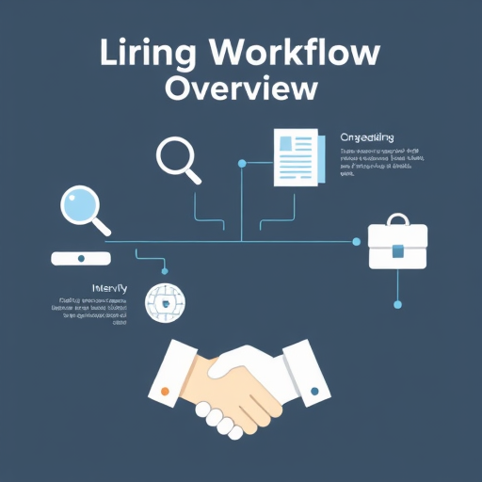
Conclusion
Role Importance: Each key role contributes uniquely to streamline the hiring workflow, enhancing overall recruitment success.
Collaborative Efforts: Effective hiring relies on strong collaboration among Hiring Manager, HR/Recruiter, and ATS functionalities.
Continuous Improvement: Regular feedback and process evaluation are vital for refining each step in the hiring workflow.
Generated on aidocmaker.com

Slide 15
Q&A
Question Facilitation: Encourage open dialogue, allowing participants to seek clarifications on any hiring workflow process aspects.
Common Concerns: Address frequent inquiries regarding candidate selection criteria, interview protocols, and onboarding nuances specifically.
Resource Accessibility: Provide supplementary materials or links for deeper understanding of referenced hiring process stages and responsibilities.

Slide 16
Thank You
Thank You: We appreciate your attention; your engagement is vital for evolving our hiring workflow practices.
Further Discussion: Feel free to reach out for clarifications or deeper insights into specific parts of the process.
Contact Information: For inquiries, please connect via email or professional networks to continue the conversation.

